Slide 1
Prepare for the PSAT/NMSQT®:
A Step to the Future

Slide 2


A Brief Overview of the Presentation
Notify students and parents about the PSAT/NMSQT ®:
What is the PSAT/NMSQT?
Skills Tested on the PSAT/NMSQT
Sample PSAT/NMSQT Questions
Test Preparation Strategies
Notes:
Note to Presenter: This PowerPoint presentation contains information about preparing for the Preliminary SAT/National Merit Scholarship Qualifying Test (PSAT/NMSQT®). Use the presentation along with the Official Student Guide to the PSAT/NMSQT to familiarize your students with the test and types of questions it contains.
Additional materials for preparing students, parents, and school staff are available at www.collegeboard.org/psatdownloads.

Slide 3
What is the PSAT/NMSQT?
Notes:
Let’s start with the basics. What is the PSAT/NMSQT?

Slide 4
What is the PSAT/NMSQT®?
Measures academic skills you’ll need for college
Co-sponsored by the College Board and National Merit Scholarship Corporation
Serves as an entry point to National Merit Scholarship Corporation competitions and practice for the SAT
Approximately 3.5 million students participate each year (44% eleventh-graders and 56% tenth-graders or younger)

Slide 5
Benefits of the PSAT/NMSQT®
Preparation for the SAT®
Scholarship and recognition opportunities (11th grade)
College and career planning tools
Admissions and financial aid information from colleges
Feedback on academic skills
Notes:
Preparation for the SAT: Same question types, format, and testing conditions as the SAT.
Scholarship and recognition opportunities: Entry point for National Merit Scholarship Corporation programs (usually in 11th grade) and other scholarship and recognition opportunities, including the National Hispanic Recognition Program.
Feedback on academic skills: Personalized feedback on critical reading, mathematics, and writing skills, including specific suggestions for improvement.
College and career planning tools: Free access to My College QuickStart™, an online tool that provides personalized information and interactive college and career planning resources.
Admissions and financial aid information: Students who say “Yes” to Student Search Service® when they take the test will be eligible to receive free information from colleges and scholarship services.

Slide 6
What Skills are Tested on the PSAT/NMSQT?
The test assesses the academic skills that you’ve developed over the years, primarily through your course work.
These skills are considered essential for success in high school and college:
Critical Reading
Mathematics
Writing Skills

Slide 7

Critical Reading Questions
Use content from:
  humanities
  social studies
  natural sciences
  literature
13 Sentence
Completions
35 Passage-Based
Reading
Questions (100- to 800-word passages)
Notes:
There are two 25-minute critical reading sections that contain a total of 48 questions.

Slide 8
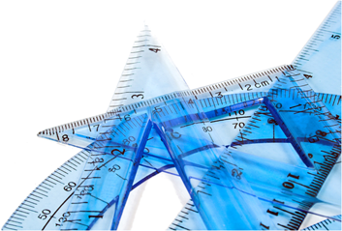
Mathematics Questions
Use content from:
  -number and operations
  -algebra and functions;
  -geometry and measurement
  -data analysis
  -statistics
  -probability
28 Multiple-Choice
Questions
10 Student-Produced
Response Questions (“Grid-ins”)
Notes:
There are two 25-minute mathematics sections that contain a total of 38 questions.

Slide 9

Writing Skills Questions
Focus on editing, grammar,
usage, and organization.
20 Improving Sentences
Questions
14 Identifying Sentence
Error Questions
5 Improving Paragraph Questions
Notes:
There is one 30-minute writing section that contains a total of 39 questions.

Slide 10
How does the PSAT/NMSQT ® compare to the SAT®?
Question Types:
  The same, except the PSAT/NMSQT does not have an essay component.
Length:
  The PSAT/NMSQT is 2 hours, 10 minutes.
  The SAT is 3 hours, 45 minutes.
Level of Difficulty:
  The PSAT/NMSQT does not have 11th grade-level math questions.

Slide 11
Sample Questions
Notes:
Additional sample questions and test taking tips are available in the Official Student Guide to the PSAT/NMSQT.

Slide 12
Critical Reading: Sentence Completions
Roger said the report was significant; Heather contradicted him, saying that all the information presented was _______ .
Because Heather is contradicting Roger, the correct response is the word that is most nearly the opposite of “significant.”
Choice (E) is correct.
“Immaterial” means inconsequential or irrelevant.
Information that is immaterial is by definition not significant.
(A) contemporary
(B) scintillating
(C) objective
(D) irrevocable
(E) immaterial
Notes:
SENTENCE COMPLETIONS measure knowledge of the meaning of words and ability to understand how the different parts of a sentence fit logically together.
Choice (A) is incorrect. To say that the information is contemporary, or current, is not to contradict its significance.
Choice (B) is incorrect. "Scintillating" means sparkling or brilliant. It is possible for a report to be both significant and scintillating, so Heather would not be contradicting Roger if she described the report in this way.
Choice (C) is incorrect. Heather would not be contradicting Roger if she said the report was objective, or unbiased. A report can easily be both significant and objective.
Choice (D) is incorrect. "Irrevocable" means unable to be taken back. This term is not the opposite of "significant" and therefore doesn't indicate a contradiction.

Slide 13
Critical Reading: Passage-Based Questions
Passage Excerpt:
After I left the room, I began to sift my impressions. Only the day before, an acquaintance had warned me to watch carefully for sleight-of-hand tricks, especially as the man had earlier been a stage conjuror.
Question: The “acquaintance” mentioned in line 2 can best be described as a
The acquaintance mentioned in line 2 warns the author to “watch carefully for sleight-of-hand tricks.”
Choice (A) is correct.
In warning the author to watch out for tricks, the acquaintance is showing that he is skeptical about the telepathist's supposed powers.
(A) skeptic
(B) hypocrite
(C) hoaxer
(D) confidant
(E) mystic
Notes:
PASSAGE-BASED READING questions measure the ability to understand words, recognize significant information, make inferences, recognize implications, and follow the author’s logic or argument.
Choice (B) is incorrect. There is nothing in the passage to suggest that the acquaintance is a hypocrite; rather, it is the acquaintance who suggests that the telepathist may be a hypocrite.
Choice (C) is incorrect. The acquaintance tries to warn the author about a potential hoaxer. But there is nothing to indicate that the acquaintance is a hoaxer.
Choice (D) is incorrect. The acquaintance cannot be described as a "confidant" because nothing indicates that he has been the recipient of confidences.
Choice (E) is incorrect. Nothing indicates that the acquaintance can be described as a mystic, or one who practices mysticism.

Slide 14
Math Section: Multiple Choice
If ax + bx = 36, what is the value of x when a + b = 12?
3
6
(C) 12
(D) 24
(E) 48
The expression ax + bx is equivalent to (a + b) x, so the equation ax + bx = 36 is equivalent to (a + b) x = 36.
When a + b = 12, the equation becomes 12x = 36, which can be solved to get x = 3.

Slide 15
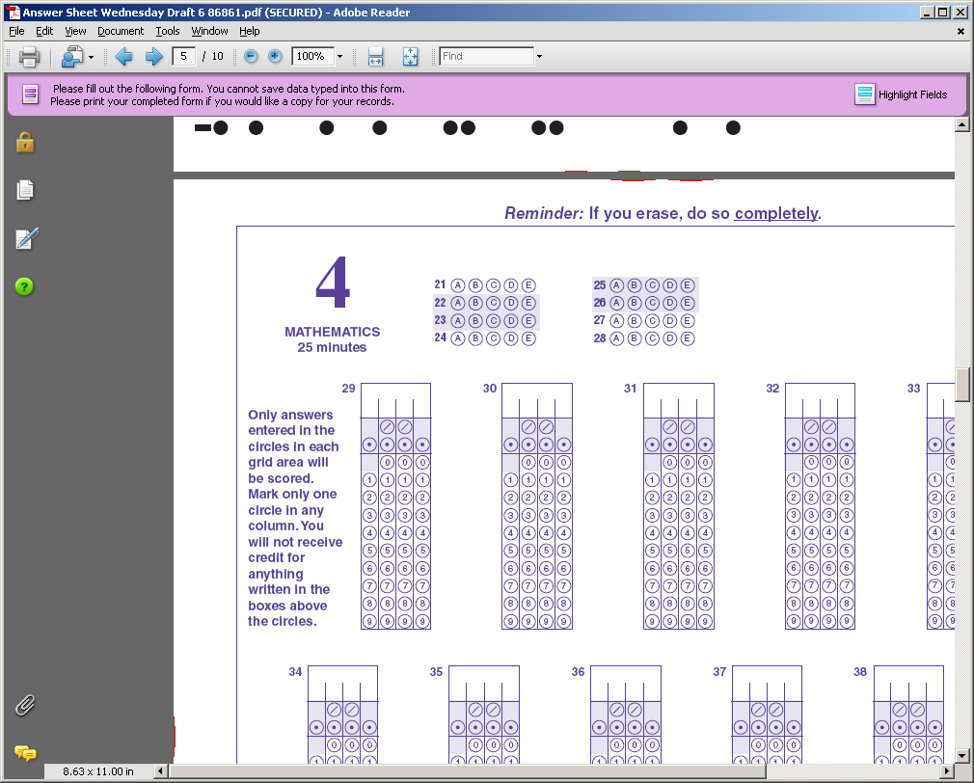
Math Section: Student-Produced Response
Know the Student-Produced Response Directions! The correct answer must be gridded correctly to receive credit. What is written in the boxes is not scored.
h
4
1
3
5h
6
If
+
=
, then what is the value of h?
4
/
7
Multiply each member of the equation by 12 (the common denominator) to get
3h + 4 = 10h
Subtract 3h from both sides to get 7h = 4
Divide by 7
h = 4/7
Notes:
STUDENT-PRODUCED RESPONSE questions do not have answer choices. Answers are recorded on this grid.
To put the answer (4/7) on the grid, first write 4, then the fraction bar (slash), and then 7 in the spaces above the grid. It does not matter whether you start at the first space at the left or finish in the last space at the right. If the answer were 2, we could put the 2 in any one of the four answer spaces and bubble in the 2 below it. THE ANSWER MUST BE BUBBLED on the grid in order to receive credit. Incorrect gridding of the answer (ending up different from the one written in the spaces) is one of the most common errors and a sure way to lose points.
Note to Presenter: The directions for recording answers to STUDENT-PRODUCED RESPONSE questions are written in the test booklet and in the Official Student Guide to the PSAT/NMSQT. Students should read the directions before test day.

Slide 16
$1.75
2 ⅓
0.444…
20%
1
.
7
5
7
/
3
.
4
4
4
.
2
Student-Produced Responses – Sample Grids
Notes:
Note to Presenter: These are practice grids. The correct answers should be gridded as 1.75, 7/3 (or 2.33), .444, and .2. 20% can also be bubbled in as 1/5.
NOTE: If it is a repeating decimal, as in .44444…, it MUST extend to the last column. If it were to stop at .44, it would be scored as wrong.

Slide 17
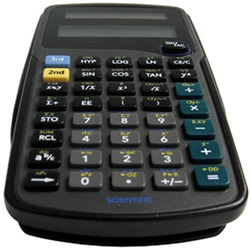
Calculators are Encouraged
A scientific or graphing calculator is recommended.
Bring a familiar calculator. Test day is not the time
to figure out how to use a new calculator.
Notes:
Additional calculator tips:
Don't try to use the calculator on every question. No question requires one.
Decide how to solve each problem; then decide whether to use a calculator.
Make sure your calculator is in good working order and that batteries are fresh.
You will not be permitted to use a pocket organizer; laptop or handheld electronic device; cell phone calculator; or calculator with QWERTY (typewriter-like) keypad, with paper tape, that makes noise or “talks,” or that requires an electrical outlet.

Slide 18
Writing Skills Section: Improving Sentences
A few barges still move oil up to Hartford, but in the old days they had more traffic then.
but in the old days they had more traffic then
but in the old days traffic was heavier
but in the old days they had a lot more
whereas the traffic was a lot more in the old days
(E) whereas then there was more traffic in the old days
(Note: In this question type, the first choice (A) always repeats the underlined phrase exactly, indicating that there should be no change.)
Choice (B) is correct. It avoids the errors of the original by eliminating both the unnecessary adverb, “then,” and the vague pronoun, “they.”
Notes:
Note to Presenter: The Writing Skills section of the PSAT/NMSQT does not require students to write an essay. However, through multiple-choice questions, it tests the ability to identify effective expressions in standard written English, to recognize faults in usage and structure, and to chose effective revisions in sentences and paragraphs.
IMPROVING SENTENCES questions require you to choose the best, most effective form of a sentence.
Choice (A) involves a pronoun error and creates redundancy. The pronoun "they" has no logical antecedent in the sentence. The adverb "then" is unnecessary, conveying nothing more than was earlier conveyed by the adverbial phrase "in the old days."
Choice (C) introduces a vague pronoun. The sentence contains no noun to which the pronoun "they" can logically refer.
Choice (D) involves improper predication. The phrase "a lot more" is inappropriately used as a predicate adjective; its proper use is as an attributive adjective modifying a noun, as in "there was a lot more traffic."
Choice (E) involves redundancy. The adverb "then" unnecessarily duplicates the meaning of the subsequent adverbial phrase "in the old days."

Slide 19
Writing Skills Section: Identifying Sentence Errors
The electronic computer is a technological triumph that scientists have developed,
mastered, and then put it to constantly increasing use. No Error.
A B C D E
The error in this sentence occurs at (B), where an unnecessary pronoun is used.
The object of the verb “have . . . put” (like the object of the verbs “have developed” and “have . . . Mastered”) is the relative pronoun “that,” which refers to “technological triumph.”
The pronoun “it” is therefore unnecessarily inserted after “put.”
Notes:
In IDENTIFYING SENTENCE ERRORS questions, certain parts of the sentence are underlined. Read the entire sentence and determine if there is an error. Note that some sentences contain no error and that no sentence contains more than one error. If the sentence contains an error, choose the letter under the underlined mistake as the answer choice. Correct answer is on the next slide.
There is no error at (A). The past participle "mastered" properly joins the helping verb "have" to form the present perfect tense.
There is no error at (C). The adverb "constantly" appropriately modifies the participle "increasing."
There is no error at (D). The participle "increasing" functions properly, modifying the noun "use."

Slide 20
Writing Skills Section: Improving Sentences
A few barges still move oil up to Hartford, but in the old days they had more traffic then.
but in the old days they had more traffic then
but in the old days traffic was heavier
but in the old days they had a lot more
whereas the traffic was a lot more in the old days
(E) whereas then there was more traffic in the old days
(Note: In this question type, the first choice (A) always repeats the underlined phrase exactly, indicating that there should be no change.)
Choice (B) is correct. It avoids the errors of the original by eliminating both the unnecessary adverb, “then,” and the vague pronoun, “they.”
Notes:
Note to Presenter: The Writing Skills section of the PSAT/NMSQT does not require students to write an essay. However, through multiple-choice questions, it tests the ability to identify effective expressions in standard written English, to recognize faults in usage and structure, and to chose effective revisions in sentences and paragraphs.
IMPROVING SENTENCES questions require you to choose the best, most effective form of a sentence.
Choice (A) involves a pronoun error and creates redundancy. The pronoun "they" has no logical antecedent in the sentence. The adverb "then" is unnecessary, conveying nothing more than was earlier conveyed by the adverbial phrase "in the old days."
Choice (C) introduces a vague pronoun. The sentence contains no noun to which the pronoun "they" can logically refer.
Choice (D) involves improper predication. The phrase "a lot more" is inappropriately used as a predicate adjective; its proper use is as an attributive adjective modifying a noun, as in "there was a lot more traffic."
Choice (E) involves redundancy. The adverb "then" unnecessarily duplicates the meaning of the subsequent adverbial phrase "in the old days."

Slide 21
Writing Skills Section: Improving Paragraphs
(1) The last century was a time of great technological progress. (2) Life is more convenient, comfortable, and efficient today than ever before. (3) Yet this has created new concerns.
Which of the following versions of sentence 3 (reproduced below) is most effective?
Yet this has created new concerns.
Although this has created new concerns.
Yet this progress has created new concerns.
Yet these have created new concerns.
Yet this has created new concerns to worry about.
New concerns have been created.
Choice (B) is correct. The vague pronoun “this” is replaced by “this progress,” which clearly refers to the progress mentioned in sentence 1.
Notes:
IMPROVING PARAGRAPHS questions ask students to make choices about improving the logic, coherence, or organization in a flawed passage. The directions explain that the test taker is looking at an early draft of an essay and that some parts need to be rewritten. This process of revision is what students do to improve their own writing or critique the writing of others. The correct answer to this question is on the next slide.
Choice (A) is unsatisfactory because it creates a sentence fragment--a subordinate clause that is unattached to a main clause.
Choice (C) is unsatisfactory because the plural pronoun "these" is vague and does not agree with the singular noun to which it presumably refers, "progress."
Choice (D) is unsatisfactory because it fails to clarify the reference of the demonstrative pronoun "this" and introduces a redundancy with the unnecessary addition of the modifier "to worry about" to the word "concerns."
Choice (E) is unsatisfactory because the weak passive construction fails to identify the cause of the new concerns and therefore establishes no link with the previous sentences.

Slide 22
Test Preparation Strategies

Slide 23
Know How the PSAT/NMSQT Is Scored
              Multiple-choice questions:
              1 point for each correct
¼ point deducted for each incorrect
Math grid-ins:
1 point for each correct
0 points for each incorrect
              0 points for omitted questions
              Scale:
              20-80 for each test section

Slide 24
Personalized Skills Information
The PSAT/NMSQT Score Report:
contains information to help you improve your academic skills.
lists skills that you have the best chance of improving with additional work.
includes advice, written by teachers, on how to improve those skills.

Slide 25
Test Preparation: Long-Term
READ!
Continuous reading improves vocabulary and develops essential skills.
Read more books than just those required for class.
  Take Challenging Courses!
  This will help you to develop and strengthen your critical thinking skills.

Slide 26
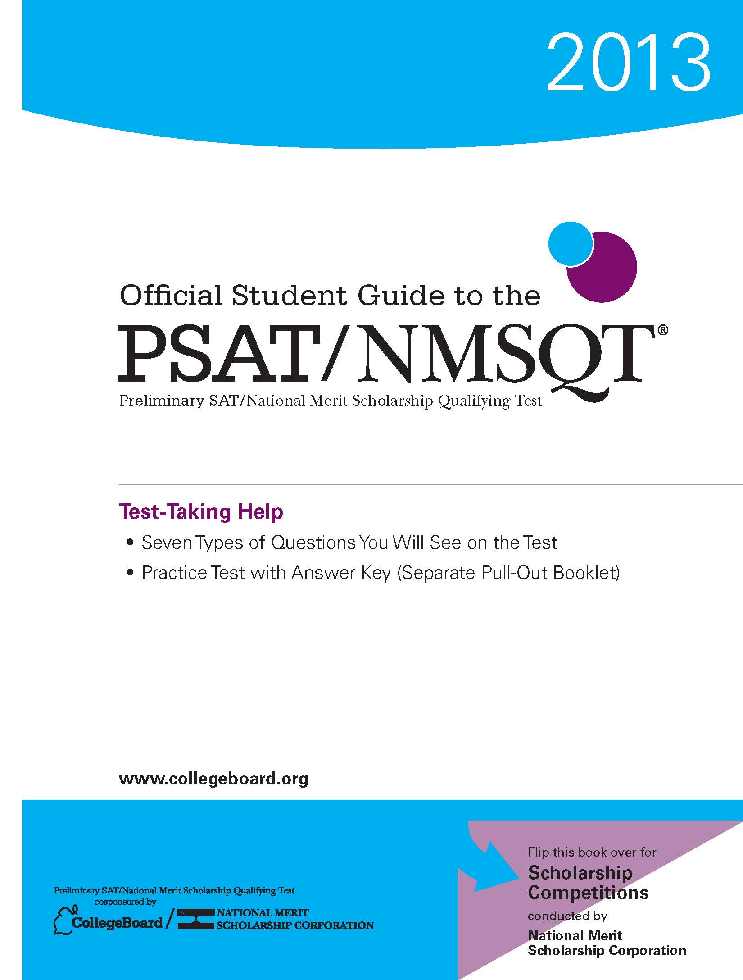
Test Preparation: Short-Term
Take the practice test in the Official Student Guide to the PSAT/NMSQT.
Understand scoring and “educated guessing.”
Familiarize yourself with the test’s format, questions types, and directions.

Slide 27
Test Preparation: Test Readiness Strategies
When you sit down to take the test:
  Read all of the directions.
  Read all of each question’s answer choices.
  Do scratch work in the test book.
  Work at a steady pace.
If you skip a question:
  Note it in the test book.
  Leave it blank on the answer sheet.
  Return to it if there is time.
  Remember: you don’t have to answer every question to score well.
Notes:
Note to Presenter: Students can make an educated guess by eliminating one or more wrong choices; they increase their chances of choosing the correct answer and earning one point. However, students should avoid wild or random guessing.

Slide 28
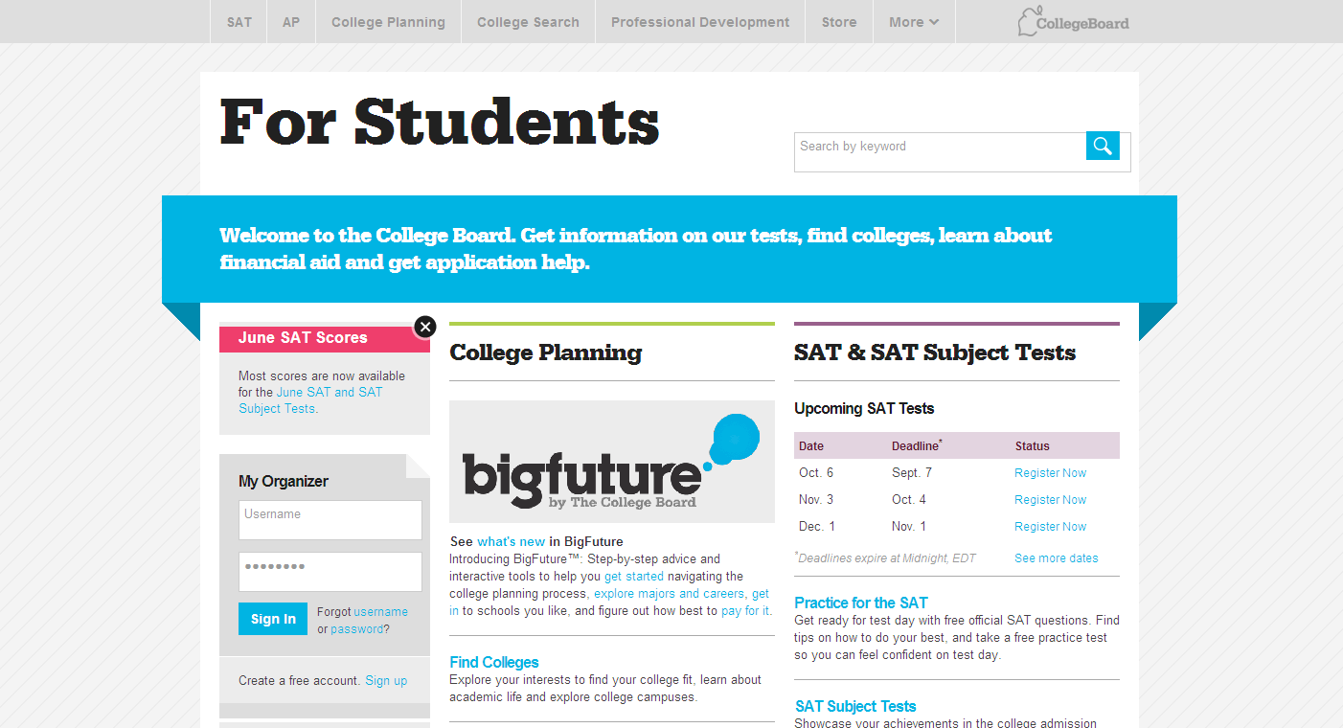
Visit collegeboard.org

Slide 29
Take the PSAT/NMSQT
How to Sign Up: _____________________________________
Test Day/Date: _____________________________________
Time: _____________________________________
Location: _____________________________________
Bring:
Two #2 Pencils
Calculator (optional)
Notes:
Note to Presenter: Use this slide to inform your students about the PSAT/NMSQT test day by editing the slide in Microsoft PowerPoint. Provide the important facts, such as day, date, and location of testing, as well as a reminder to bring a calculator (optional) and #2 pencils. Remember, Social Security numbers and email addresses are optional. You may also want to include information about the cost of the test; where and when they register (with a deadline date); and anything else that you think they’ll need to know.

Slide 30
PSAT/NMSQT
A Step to the Future

